Slide 1
eGov Ecosystem and Infrastructure

Slide 2
The e-Governance Roadmap…
Vision
Strategy
Blueprint
Program
Ecosystem

Slide 3
What is an eGov Roadmap ?
A set of comprehensive documents that
provide a vision
indicate a direction
set a pace
create a set of methodologies
lay down priorities
enable resource mobilization
facilitate adoption of holistic approach
… in implementing e-Government

Slide 4
eGovernance Ecosystem
E-Government Strategy and Plan
National Enterprise Architecture
Open Government Standards

Slide 5
eGovernance Infrastructure
National Optical Fiber Network (NOFN)
State-Wide Area Networks (SWANs)
National/State/Local Data Centres
National/State/District/Departmental Portals
Common Service Centres

Slide 6
E-Government and Strategy
E-government is very simply about applying information and communication technology to all aspects of a government’s business where it makes sense to improve efficiency and effectiveness in the achievement of policy and program outcomes
E-Government strategy might comprise of
Conceptual framework
Business case
Implementation Process
Measurement of results

Slide 7
Why an e-Gov. strategy?
To pursue real economic development goals not just “technology push”
To create right policy and institutional frameworks from start
To maximize effectiveness of ICT initiatives within Government
To manage the increasing costs of I&IT in government
To generate savings by applying I&IT in backend processes or other programmatic areas
To map path from pilot experiments to sustainable, scalable systems
To design technology architecture (infrastructure, data, standards) for the public sector
To integrate organizational silos and deliver citizen services through common channels

Slide 8
Conceptual Framework for E-Government Strategy
Dimensions
Outputs
Goals
Leadership
E-Governance:
Legal Framework,
ICT Policies - Standards
TRANSPA-RENCY
Human Resource Dev.
Connectivity & Data Processing infrastructure
SERVICE
Policy & Institutional Reform
Institutional Infrastructure for Service Delivery
EFFICIENCY
Client-Oriented Service Applications
Technology
ECONOMY
Back-End Government Applications
Financing

Slide 9
Making a business case
Defining worthwhile goals
To extend the reach of government services
To promote equal access to government services
To increase constituency satisfaction with government services
To reduce government costs
Demonstrating financial feasibility
Incremental investment financing
Cost sharing with business

Slide 10
Making a business case
Demonstrating financial sustainability
Redirection of line ministry HRD and ITC budgets
Savings accrued over time from BPR, automation and outsourcing of client interface
Developing incentive scheme
Individuals: professional development, increased autonomy, international exposure
Departments: Increased budgetary control, organizational visibility, share of profits/savings

Slide 11
Implementation Process
Define vision and goals
Set up high level leadership task force
Ensure consistency with economic development priorities
Assess status quo
Secure political support
Establish stakeholder participation mechanisms
Put in place e-govt. management framework
Assess priority needs for government services
Secure funding

Slide 12
Implementation Process
Establish partnerships with private sector, where feasible
Design technical, data sharing, and service delivery infrastructure.
Prioritize projects (BPR first)
Develop time-bound implementation plan
Secure stakeholder buy-in of implementation plan
Implementation the strategy in phases
Measure and publicize progress
Evaluate results and make course corrections.

Slide 13
Measurement of results
A few illustrative output Indicators are as follow:
Infrastructure
Improvement in connectivity and data processing capacity
Governance
E-government management framework in place
Policy and regulatory framework in place
Institutional Capacity
Geographical reach of government services
Training imparted
Business processes reengineered
No. of Govt. systems operating at service standards

Slide 14
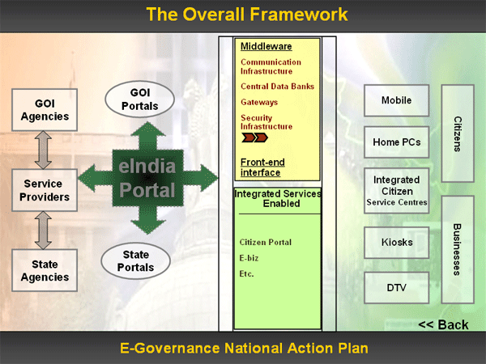
India e-Government Architecture

Slide 15
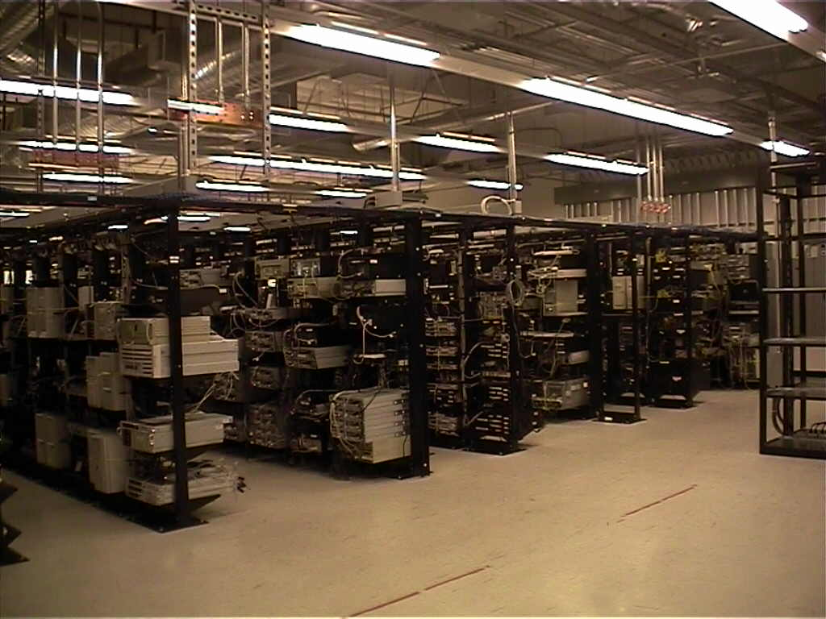
Data Centers
A View of Data Center

Slide 16
A Data Center
Data centers are highly secure, fault-resistant facilities housing equipment that connect to telecommunications networks.
The facilities accommodate servers, switches, routers, modem racks.
Data centers support corporate databases, websites and provide locations for service providers (e.g. ISP, ASP), Web hosting companies, and other IT services.
A standard for measuring equipment space in a data center is Rack Location Units (RLUs)

Slide 17
Data Center Components
Basic Data Center facility systems:
Physical space
Raised flooring
In-room electrical
Standby power
Data cabling
Cooling
Fire suppression

Slide 18
Data Center Design Criteria
How many layers of infrastructure should your Data Center possess?
Will it be the only server environment for your company or one of several?
Will the room house production servers and be a business-critical site or contain a minimum of equipment for disaster recovery purposes and serve as a failover location?
How long is its initial construction expected to meet your company's needs?
What is it all going to cost?

Slide 19
Data Center Design Criteria
Availability
Infrastructure Tiers
One Room or Several?
Life Span
Budget Decisions

Slide 20
Data Center Design Criteria
Availability:
The degree to which Data Center devices function continuously is known as the room's availability or its uptime.
Availability is represented as a percentage of time.
How many days, hours, and minutes is the Data Center's electrical infrastructure operational and supplying power over a given time period

Slide 21
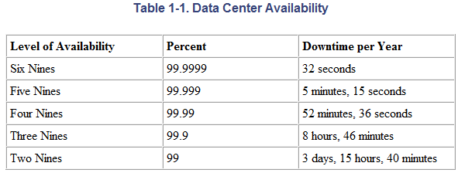
Data Centre Availability

Slide 22
Data Center Design Criteria
Infrastructure Tiers
The higher the availability you want your Data Center to achieve, the more layers of infrastructure it must have.
N capacity is the amount of infrastructure required to support all servers or networking devices in the Data Center, assuming that the space is filled to maximum capacity and all devices are functioning.
N most commonly used when discussing standby power, cooling, and the room's network.
N+1 infrastructure can support the Data Center at full server capacity and includes an additional component
Alternately called a 2N or system-plus-system design, it involves fully doubling the required number of infrastructure components
Even higher tiers exist or can be created: 3N, 4N, and so on.

Slide 23
Data Center Design Criteria
One Room or Several?
One large Data Center is simpler to manage than several smaller ones.
Having only one server environment puts all of your eggs in one basket.

Slide 24
Data Center Challenges
Traffic load balance
Support for virtual machine (VM) migration
Achieving bisection bandwidth
Power savings / Cooling
Network management (provisioning)
Security (dealing with multiple tenants)

Slide 25
Common Data Center Topology
Internet
Data Center
Core
Layer-3 router
Aggregation
Layer-2/3 switch
Access
Layer-2 switch
Servers
Notes:
Before describing the problems with current middlebox deployment approaches, let me first describe the commonly used 3-tier data center network topology. At the top is the core-tier, whose layer-3 routers connect the data center to the Internet or to the rest of the campus network. At the bottom is the access tier, containing the layer-2 switches into which servers are plugged in.
In between the access and core tiers are the layer 2/3 switches of the aggregation tier. Middleboxes are commonly deployed at the aggregation tier.
Multiple redundant links connect together the various switches and servers. To prevent forwarding loops, we use mechanisms like spanning tree construction to block out some of the links. For example, the topology as shown here.

Slide 26
Data Center Network Topology
Internet
CR
CR
. . .
AR
AR
AR
AR
S
S
S
S
S
S
. . .
A
A
…
A
A
A
…
A
Key
CR = Core Router
AR = Access Router
S = Ethernet Switch
A = Rack of app. servers
~ 1,000 servers/pod

Slide 27
Requirements for future data center
To catch up with the trend of mega data center, DCN technology should meet the requirements as below
High Scalability
Transparent VM migration (high agility)
Easy deployment requiring less human administration
Efficient communication
Loop free forwarding
Fault Tolerance
Current DCN technology can’t meet requirements.
Layer 3 protocol can not support the transparent VM migration.
Current Layer 2 protocol is not scalable due to the size of forwarding table and native broadcasting for address resolution.

Slide 28
Problems with Common Topologies
Single point of failure
Over subscription of links higher up in the topology
Tradeoff between cost and provisioning

Slide 29
Reminder: Layer 2 vs. Layer 3
Ethernet switching (layer 2)
Cheaper switch equipment
Fixed addresses and auto-configuration
Seamless mobility, migration, and failover
IP routing (layer 3)
Scalability through hierarchical addressing
Efficiency through shortest-path routing
Multipath routing through equal-cost multipath
So, like in enterprises…
Data centers often connect layer-2 islands by IP routers

Slide 30
Need for Layer 2
Certain monitoring apps require server with same role to be on the same VLAN
Using same IP on dual homed servers
Allows organic growth of server farms
Migration is easier

Slide 31
Review of Layer 2 & Layer 3
Layer 2
One spanning tree for entire network
Prevents loops
Ignores alternate paths
Layer 3
Shortest path routing between source and destination
Best-effort delivery
Notes:
In this talk, I shall next explain the problems with current middlebox deployment mechanisms.
I shall then describe how our solution, the policy-aware switching layer simplifies middlebox deployment and achieves the properties I mentioned earlier.
I shall briefly discuss related work, and our prototype implementation and evaluation of the policy-aware switching layer.

Slide 32
Data Center Traffic Engineering
Challenges and Opportunities

Slide 33

Wide-Area Network
. . .
. . .
Data Centers
Servers
Servers
Router
Router
DNS Server
Internet
Clients
DNS-based
site selection

Slide 34
Wide-Area Network: Ingress Proxies
. . .
. . .
Data Centers
Servers
Servers
Router
Router
Proxy
Proxy
Clients

Slide 35
Traffic Engineering Challenges
Scale
Many switches, hosts, and virtual machines
Churn
Large number of component failures
Virtual Machine (VM) migration
Traffic characteristics
High traffic volume and dense traffic matrix
Volatile, unpredictable traffic patterns
Performance requirements
Delay-sensitive applications
Resource isolation between tenants

Slide 36
Traffic Engineering Opportunities
Efficient network
Low propagation delay and high capacity
Specialized topology
Fat tree, Clos network, etc.
Opportunities for hierarchical addressing
Control over both network and hosts
Joint optimization of routing and server placement
Can move network functionality into the end host
Flexible movement of workload
Services replicated at multiple servers and data centers
Virtual Machine (VM) migration

Slide 37
State Data Centre (SDC) has been identified as one of the important element of the core infrastructure for supporting e-Governance initiatives of National eGovernance Plan (NeGP).
Under NeGP, it is proposed to create State Data Centres for the States to consolidate services, applications and infrastructure to provide efficient electronic delivery of G2G, G2C and G2B services. These services can be rendered by the States through common delivery platform seamlessly supported by core Connectivity Infrastructure such as State Wide Area Network (SWAN) and Common Service Centre (CSC) connectivity extended up to village level. State Data Centre would provide many functionalities and some of the key functionalities are Central Repository of the State, Secure Data Storage, Online Delivery of Services, Citizen Information/Services Portal, State Intranet Portal, Disaster Recovery, Remote Management and Service Integration etc. SDCs would also provide better operation & management control and minimize overall cost of Data Management, IT Resource Management, Deployment and other costs.
Department of Information Technology (DIT) has formulated the Guidelines to provide Technical and Financial assistance to the States for setting up State Data Centre. These Guidelines also include the implementation options that can be exercised by the State to establish the SDC.

Slide 38
State Data Centre (SDC) has been identified as one of the important element of the core infrastructure for supporting e-Governance initiatives of National eGovernance Plan (NeGP).
Under NeGP, it is proposed to create State Data Centres for the States to consolidate services, applications and infrastructure to provide efficient electronic delivery of G2G, G2C and G2B services. These services can be rendered by the States through common delivery platform seamlessly supported by core Connectivity Infrastructure such as State Wide Area Network (SWAN) and Common Service Centre (CSC) connectivity extended up to village level. State Data Centre would provide many functionalities and some of the key functionalities are Central Repository of the State, Secure Data Storage, Online Delivery of Services, Citizen Information/Services Portal, State Intranet Portal, Disaster Recovery, Remote Management and Service Integration etc. SDCs would also provide better operation & management control and minimize overall cost of Data Management, IT Resource Management, Deployment and other costs.
Department of Information Technology (DIT) has formulated the Guidelines to provide Technical and Financial assistance to the States for setting up State Data Centre. These Guidelines also include the implementation options that can be exercised by the State to establish the SDC.

Slide 39
National Panchayat Portal (http://panchayat.nic.in)
73rd Amendment Act enacted in 1992 to enhance the democratic set up by establishing the third-tier of the government, the Panchayati Raj Insitutions (PRIs) to work at district-, block- and village- levels
Ministry of Panchayati Raj (MoPR), Government of India formed in 2004 to work for the effective implementation of Panchayati Raj or local self governance in the country
There are about: 31 State Panchayat Raj Departments , 536 District Panchayats or Zilla Parishads (ZPs), 6096 Block Panchayats/Intermediate Panchayats (BPs/IPs) and 2,40,000 Gram panchayats/Village Panchayats (GPs/VPs)

Slide 40
Challenges of Information Dissemination & Management
The sheer no. of portals to be created and maintained is mind boggling
Maintenance of the web site
Lack of technical skills to manage and maintain web sites
Lack of proper review and approval mechanism,
Inconsistency in the information published through different media
Linguistic diversity
Remoteness of the institutions
Poor Network Connectivity

Slide 41
NPP–Collaborative Portal Generation
Dynamically generates portals for Ministry of Panchayati Raj, all 35 State Panchayati Raj departments, all 560 district panchayats, 6096 intermediate panchayats and 2,40,000 village panchayats in the country
Portal site acts as a window to information & services provided by the respective PRI
Portals tailored for respective PRI in terms of: Page Layout, Content Presentation, Language, Visual Theme
The portals can collaborate with one another to share the resources of the framework such as content, page layout, visual theme, etc.

Slide 42
NPP – Content Presentation & Organization
Portal Pages- A PRI portal site may present content in more than one web page format called portal page to cater to different sections of the citizen or different focus areas of the community. For eg., Farmer’s page, Health Page, Student’s Page
Portlets - Each portal page is divided up into sections called portlets, e.g. Content Portlets , Navigation Portlets and Opinion Portlets

Slide 43
NPP – Language Support
Each PRI portal site could use one or more languages used by its community
UNICODE standards-based
Hindi, English and other regional languages (which have been UNICODE enabled)
Easier to mix languages, share with others
Multiple language support on each portal site
Easy switching to another language supported by the site without disconnecting from the site
User-friendly screens to add or customize a language version as per local needs

Slide 44
NPP – Powerful Search Facility
Simple Search: by word or phrase (exact or any word)
Metadata-based search: based on Dublin-Core metadata tags used to define the content such as subject, author, date published or status etc.
Search in title, abstract, typed text or attached files (doc, pdf,ppt etc.) of the content item
Search across multiple languages supported by the site

Slide 45
NPP – Visual Themes
A visual theme defines the colour scheme, header images, logos etc.
Each PRI can define its own theme
The theme for a PRI portal site can be set simply by selecting a theme for the site
PRIs can exchange themes amongst themselves

Slide 46
User Management
Role-based Privileges
Viewer
Contributor
Editor
Content Manager
Site Designer
User Manager
System Administrator
NPP provides two user groups by default: citizen, operator and manager
Each PRI could use the default user groups or create their own user groups as per their need

Slide 47
NPP - Authentication
General public need not login to browse the information provided by the portal site
General public can, however, self-register as citizens to take advantage of facilities provided by portal site for authenticated users such as messaging facility
PRI officials must login if they want to do more than just browse the site.

Slide 48
NPP – Content Management
Content Creation
Content Editing & Versioning
Content Publishing
Content Indexing
Garbage Management
Content Flow Management

Slide 49
NPP – Collaborative Content Management
Each site could be configured to allow content flow across various users to ensure that the content is appropriately edited, approved and then published.
Currently, each site has two types of users: operator and manager
Operator can create and edit content
Manager can edit content created by operators as well as self
Only managers can publish content
Publish
Content
Manager
Edit/ Approve
Operator

Slide 50
NPP - Messaging
Provides message facility to send 'mails' between users of different PRI sites.
This could be used by citizens to send messages to one another as well as to PRI officials and vice versa, without a need to access an e-mail server and Internet
Users may belong to different PRI portal sites which may be distributed across systems
Similar to e.g. Yahoo mail, but works without Internet.

Slide 51
NPP – Future Directions
NPP – A semantic Web Portal
Already, NPP captures metadata related to content.
Further, some basic common classification has been achieved by standardizing on subject areas and types of content (which are same for all government agencies). This gives capability to search across languages in a given subject area or type of content
It is proposed to semantically enhance the current search capability of NPP by linking it to domain ontology
This would enable users to query for information or services across portal sites and across languages using any domain-specific concept
Further, it is proposed to enhance the portal framework as an ontology-building tool

